Slide 1
Nutritional Disorders Vitamins and Minerals (The Micronutrients)
Dr. Zainab A. Al-Mayyahi
Department of Medicine
College of Medicine
University of Basrah

Slide 2
Vitamin K

Slide 3
Vitamin K
Vitamin K is a fat-soluble vitamin which plays a vital role in the coagulation system.
Two natural forms of vitamin K:
Vitamin K₁( phylloquinone): from vegetable and animal sources.
Vitamin K₂ ( menaquinone): which is synthesized by bacterial flora.

Slide 4
Sources and daily requirements
Sources of vitamin K : green leafy vegetables such as spinach, margarine, liver and vegetable oils like olive, canola, and soybean oils.
Daily requirement :100 μg /d.

Slide 5
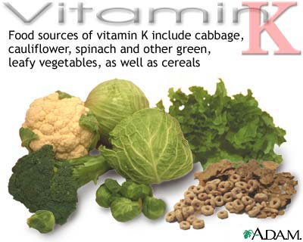
RDA is 100 μg /d.

Slide 6
Functions of vitamin K
Vitamin K in it’s active form (hydroquinone) is required for carboxylation of glutamic acid, which is necessary for calcium binding to some important coagulation proteins such as prothrombin (factor II) , factors VII, IX, and X , protein C and protein S.

Slide 7
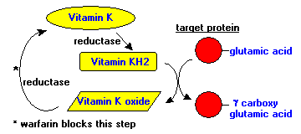
Metabolism of vitamin K
Hydroquinone
Ca++
active coagulation proteins

Slide 8
Vitamin K deficiency
Causes of vitamin K deficiency:
Malabsorption (celiac disease, Crohn's)
Obstructive biliary diseases.
Use of broad-spectrum antibiotic.
Prematurity.
Drugs ( warfarin , orlistat )

Slide 9
Clinical features of vitamin K deficiency
The main symptom of vitamin K deficiency is hemorrhage. ( bruises, hematemesis, melena hematuria, prolong bleeding after circumcision, epistaxis, intracranial hemorrhage)
Newborn infants (1–7 days after birth) are particularly susceptible to vitamin K deficiency (hemorrhagic disease of the newborn).

Slide 10
Diagnosis of vitamin K deficiency
Clinical features.
Elevated prothrombin time ( PT ).
Reduced level of clotting factors( II, X, IX, VII).
Vitamin K level may also be measured directly by HPLC.

Slide 11
Treatment
Vitamin K 10 mg IM or IV.
For patients with sever bleeding FFP or blood transfusion may be required.

Slide 12
Prevention
Vitamin K (1 mg IM) is given prophylactically at birth for newborn babies.
Chronic malabsorption, 1–2 mg/d of vitamin K should be given orally, or 1–2 mg/week parenterally.

Slide 13
Vitamin E

Slide 14
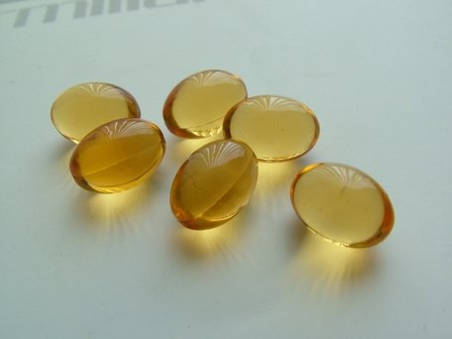
Vitamin E
Vitamin E is a fat soluble vitamin which acts as an antioxidant.

Slide 15
Vitamin E
Two isoforms:
Tocopherols.
Tocotrienols.
Only tocopherol meets human requirements.

Slide 16
Sources and daily requirement
Sources : sunflower oil, soybean, corn oils, meats, nuts, cereal grains, and small amounts are present in fruits and vegetables.
The daily requirement of vitamin E is 15 mg/d.

Slide 17
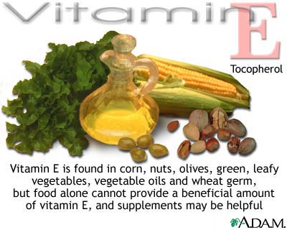
The daily requirement of vitamin E is 15 mg/d

Slide 18
Functions of vitamin E
Vitamin E protects low-density lipoproteins (LDLs) and polyunsaturated fats in cell membranes (nerve cells, RBCs ) from oxidation.
Increase sexual performance.
Improve immune function.
Prevent cardiovascular disease.
Slow aging process.

Slide 19
Vitamin E deficiency
It is extremely rare seen only in :
Severe and prolonged malabsorptive diseases (celiac disease, cystic fibrosis).
Prolonged cholestasis.
Familial vitamin E deficiency due to defect in the tocopherol transport protein.

Slide 20
Clinical features of vitamin E deficiency
Peripheral neuropathy characterized by areflexia, ataxic gait, decreased vibration and position sensations.
Ophthalmoplegia.
Skeletal myopathy.
Retinopathy.
Hemolytic anemia.
Increased susceptibility for certain viral infections.

Slide 21
Diagnosis and treatment
Diagnosis : low blood level of tocopherol.
Treatment : 800–1200 mg of tocopherol per day.
Higher doses may be required for patients with malabsorption.

Slide 22
Vitamin E Toxicity
High doses of vitamin E (>800 mg/d) may reduce platelet aggregation and interfere with vitamin K metabolism and are therefore contraindicated in patients taking warfarin.

Slide 23
Water soluble vitamins

Slide 24
Vitamin C

Slide 25
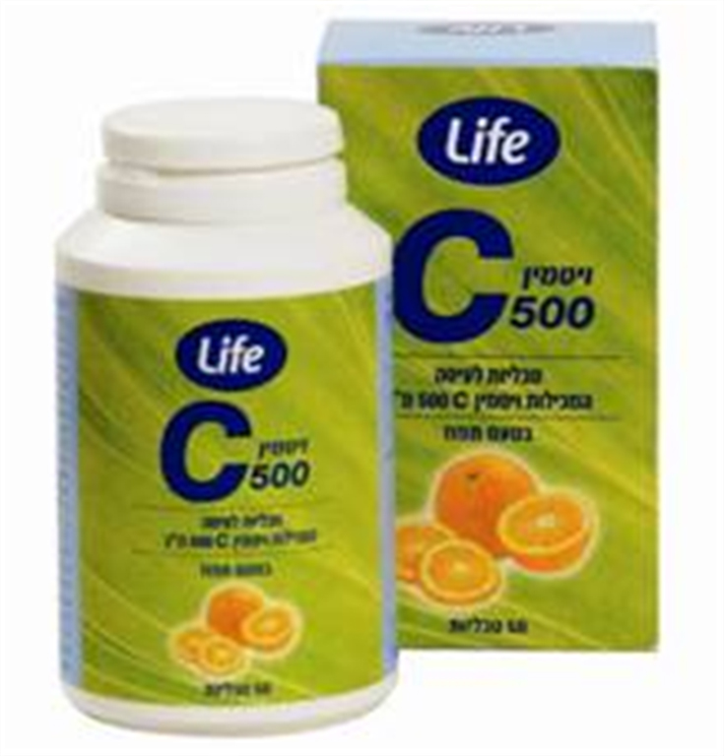
Vitamin C
Vitamin C is a water soluble vitamin which plays a vital role in connective tissue metabolism.
Notes:
s

Slide 26
Vitamin C
Tow biologically active forms:
Ascorbic acid.
Dehydroascorbic acid.

Slide 27
Sources and daily requirements
Sources of vitamin C include : Citrus fruits, green vegetables, tomatoes, and potatoes.
The daily requirement: 90 mg/d for males and 75 mg/d for females.
Smoking, hemodialysis, pregnancy, stress (infection, trauma) and drugs like steroids and NSAID appear to increase vitamin C requirements.

Slide 28
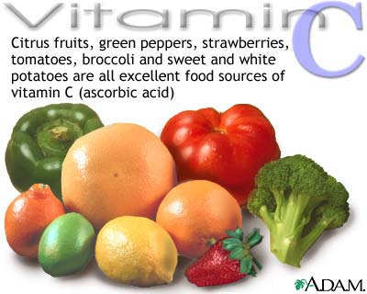

Slide 29
Functions of vitamin C
Connective tissue metabolism and cross-linking (proline hydroxylation).
Antioxidant activity (protect against cancer).
Promotion of nonheme iron absorption.

Slide 30
Functions of vitamin C
The conversion of dopamine to norepinephrine.
Synthesis of many peptide hormones.
Is a component of many enzyme systems.
In high doses decrease the severity of respiratory tract infection.

Slide 31
Vitamin C deficiency
Vitamin C deficiency causes Scurvy which is primarily reflect impaired formation of mature connective tissue.
Causes of vitamin C deficiency:
Malnutrition (lack of fresh fruits and vegetables for > 2 months).
Elderly and infants.
Alcoholics.

Slide 32
Clinical features of Scurvy
Bleeding into skin (petechiae, ecchymoses, perifollicular hemorrhages).
Inflamed and bleeding gums.
Bleeding into joints, the peritoneal cavity, GIT pericardium, and the adrenal glands.
Poor wound healing.
In children, vitamin C deficiency may cause impaired bone growth.

Slide 33
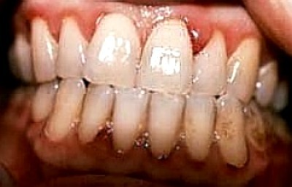

Slide 34
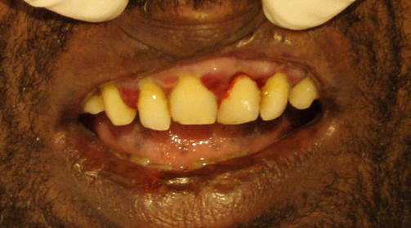

Slide 35
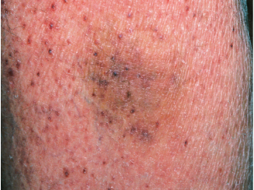

Slide 36
Diagnosis and treatment of Scurvy
Diagnosis :
Clinical features .
Low plasma or leukocyte level of vitamin C.
Treatment :
vitamin C (250 mg 8 hourly) improves the symptoms of scurvy within a matter of several days.
Encourage vitamin C rich diet.

Slide 37
Vitamin C toxicity
Acute toxicity : >2 g in a single dose may result in abdominal pain, diarrhea, and nausea.
Chronic toxicity : Chronic high-doses may result in an increased prevalence of kidney stones.
Chronic high doses may promote iron overload in patients taking supplemental iron.
High doses may induce hemolysis in patients with G6PD deficiency.

